Slide 1
U.S. Benefits Briefing
Speaker name and title
September 26, 2016

Slide 2






U.S. Benefits update
2017 benefits strategy and key messages
Benefits overview and what’s changing
Annual enrollment key dates and support
Your role as managers
Q&A
Today’s focus is on Enterprise Services employees. Some benefits will be different for other HPE employees in 2017,

Slide 3
2017 U.S. benefits strategy
Key drivers and strategic focus areas
Mitigating cost increases and health care inflation
Incorporating differentiation for ES
Financial
framework
External
competitiveness
Talent strategy
and engagement
Moving toward
more aggressive (lean) competitive market position
Continued focus
on employee choices, flexibility, and health engagement
Supporting cost
structure changes
across the business
New
financial coaching to help employees navigate through change

Slide 4




Note: The speaker notes for this slide include detailed instructions on how to customize and edit charts, like the one shown here, with your own data.
Tip! Remember to remove this text box.
U.S. benefits annual enrollment 2017
Key messages for employees
Important 2017 changes designed to drive future business success (including unique changes for ES group)
HPE continues to provide strong value and choice with benefit offerings
Learn what’s changing and review your enrollment materials
Evaluate your family’s health care needs
Use the decision-support tools and resources (new EY financial coaching support)
Enroll via MyHPEBenefifts.com
Earn wellness incentives
2017 changes are designed to drive future business success , including unique changes for ES group
HPE continues to provide strong value and choice
Important to learn what’s changing and review enrollment materials
Use the decision-support tools and resources (including the new EY financial coaching program)
Enroll via MyHPEBenefits
Earn Wellness Incentive Credits

Slide 5
2017 benefits overview and changes

Slide 6
Strategic framework for HPE benefits: 2017 strategic focus areas and key drivers
Note: The speaker notes for this slide include detailed instructions on how to customize and edit charts, like the one shown here, with your own data.
Tip! Remember to remove this text box.
2017 U.S. benefits overview: Enterprise Services employees
Medical and Rx | Dental | Vision | Life insurance | AD&D insurance
Standardized choices through the private Health Exchange Insurance carriers* Coverage levels* Range of costs* | Standardized choices through the private Health Exchange Insurance carriers* Coverage levels* Range of costs* | Standardized choices through the private Health Exchange Insurance carriers* Coverage levels* Range of costs* | Employee coverage up to 9x pay or $5M Spouse/Domestic partner coverage up to 3.5x pay or $300k Child coverage up to $20k | Employee coverage up to 9x pay or $1M Spouse/Domestic partner coverage up to 7x pay or $500k Child coverage up to $50k
Disability | LTD Dependent Health Continuation | Flexible Spending Accounts | Group Legal Services | Vacation Buy
Disability (Short-Term and Long-Term) 60% of pay* Waive coverage* | LTD Dependent Health Continuation | Health Care Flexible Spending Account (FSA) Dependent Care FSA | UltimateAdvisor UltimateAdvisor Plus | Purchase up to 40 hours
*2017 change

Slide 7
Reminder of additional benefits available
Work / life
Health & welfare
Financial and retirement
Adoption Assistance Program
Employee Assistance Program (EAP)
Employee discounts
Back-up child care and adult/elder care
Concierge and Convenience services
Wellness programs
Sick time and PTO
Vacation and holidays
Leaves of absence
Short-Term Disability
Retiree medical
Travel insurance and assistance
Business Travel Insurance
Expert Medical Opinion*
ESPP
401(k) Plan**
EY financial coaching services*
*New in 2016 **2017 change

Slide 8
Strategic framework for HPE benefits: 2017 strategic focus areas and key drivers
Planned 2017 U.S. benefits changes
Benefit | What’s new or changing | Impact to employees
401(k) Plan | Reduce match from 100% of 4% to 50% of 6%—provide annual versus quarterly | Save 6% of pay to receive full match Mid-year match available at time of spin
Medical | Transition to private exchange with standardized plans (Platinum, Gold, Silver, Bronze) through competing insurance carriers Reduced premium subsidy driving increased employee costs, but with options to buy down | Completely new set of designs and choices Higher premiums but offers expanded choice including lower cost options Must enroll to have coverage for 2017
Wellness incentives | Increased incentives up to $890 ($1,530 including spouse) Portion based on pledge to follow up on any health risks | Greater opportunities to offset 2017 premiums, but must pledge to follow up
Dental and vision | Transition to standardized exchange plans Child eligibility expanded to 26th birthday regardless of student or dependent status | New set of designs with expanded choice Ability to cover children longer, consistent with medical benefits Must enroll to have coverage for 2017

Slide 9
Strategic framework for HPE benefits: 2017 strategic focus areas and key drivers
Note: The speaker notes for this slide include detailed instructions on how to customize and edit charts, like the one shown here, with your own data.
Tip! Remember to remove this text box.
Planned 2017 U.S. benefits changes continued
Benefit | What’s new or changing | Impact to employees
Short- and Long-term disability | Convert from company-paid to voluntary benefit with reduced formula (60% of pay) and employees paying cost of coverage | Increased costs but tax-free benefits upon disability Ability to waive coverage Must enroll to have coverage for 2017
Retiree medical savings account | Discontinue Retirement Medical Savings Account including HPE match for employees hired <8/1/2008 | Plan no longer available Current balances continue to be available
Financial coaching | New company-paid financial coaching service through EY available at no cost | Get advice on benefit decisions and broader financial considerations
Group Legal | Adding new features with no increase in rates | More services available

Slide 10

Introducing the Aon Active Health ExchangeTM
Note: Detailed instructions on how to replace sample pictures like the one shown here can be found in the speaker notes of this slide.
Tip! Remember to remove this text box.
Key features
Coverage levels: Bronze, Bronze Plus, Silver, Gold, and Platinum
Choice of plan designs and carriers
Education and decision-support tools, with financial counseling support to help guide employees
Why it makes sense for ES
Ability to implement meaningful subsidy reductions while offering expanded choice and allowing employees to decide how to adapt
Aggressive carrier quotes offer savings for Silver options
New model aligned with better cost structure for ES
Aon Active Health Exchange is a trademark of Aon Corporation.

Slide 11
Aon Active Health Exchange options and carriers
Note: Detailed instructions on how to replace sample pictures like the one shown here can be found in the speaker notes of this slide.
Tip! Remember to remove this text box.
Coverage levels | Medical* carriers available | Dental carriers available | Vision carriers available
Bronze Plus (medical) Bronze (dental & vision) | Aetna BCBS Cigna Health Net Kaiser UHC | Aetna Cigna Delta MetLife UHC | EyeMed MetLife United VSP
Silver
Gold
Platinum |  |  | Platinum coverage level not available for vision
*Includes prescription drug coverage

Slide 12
Annual enrollment process and support

Slide 13
Annual enrollment: Key dates
Activity | 2016 |  |  |  | 2017
 | September | October | November | December | January
Onsite KYHN biometric screenings (24 sites)
Wellness Assessment
Onsite flu shots (24 sites)
Annual enrollment kits mail
Benefits Expos (15 sites)
Annual enrollment
KYHN Screening and Wellness Assessment deadline
Year-end closure and reminders about ID cards; payroll deductions
2017 elections effective
9/1 – 10/27
9/6 – 12/1
9/7 – 10/27
Week of 10/3
10/12 – 10/26
10/10 – 10/28
12/1
12/23 – 1/2
1/1

Slide 14



Annual enrollment communication: ES employees
4
1
2
5
3
1. Make It Yours website (9/20)
2. AE announcement MyBenefits News (9/27)
3. AE day 1 “Go enroll” email (10/10)
4. Reference guide (mails the week of 10/3)
5. HSA user’s guide (mails the week of 10/3)

Slide 15
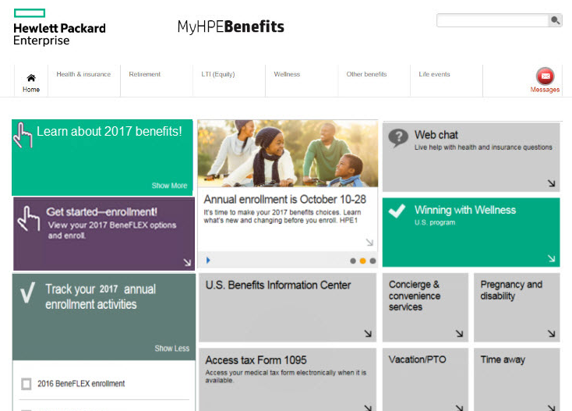

How to enroll
Note: Detailed instructions on how to replace sample pictures like the one shown here can be found in the speaker notes of this slide.
Tip! Remember to remove this text box.
Step 1
Log on to MyHPEBenefits
Step 2
Click on the tile that says “Get started—enrollment! View your 2017 BeneFLEX options and enroll.”
Decision-support tools
  Make It Yours microsite
  EY financial coaching
Notes:
Need help enrolling?
Call Hewlett Packard Enterprise Benefits Center (1-844-537-5304) and say “Annual enrollment”
Use “Chat” feature online
Representatives are available to chat between 6 a.m. and 6 p.m. Pacific Time (8 a.m. and 8 p.m. Central Time)

Slide 16

Your role as managers
Designer: Please add something to this slide…may be a storyteller graphic???
Referring employee questions
Understand changes, rationale, and key activities
Understand changes, rationale, and key activities
Support your onsite events
Demonstrate empathy for employee concerns
Do not attempt to answer questions if you’re uncertain
Refer issues or questions to appropriate resources
Reinforce business rationale for change while demonstrating empathy for employee concerns
  Make It Yours microsite for plan information
  Hewlett Packard Enterprise Benefits Center—call 1-844-537-5304 and say “Annual enrollment”
  For escalated issues, email U.S. Benefits team
  hpe.benefits.us@hpe.com
Do not attempt to answer questions if you’re uncertain
Refer issues or questions to appropriate resources

Slide 17
Questions and answers

