Slide 1

Reimagining the
Health Experience
Consumer Experience
November 2016

Slide 2




Today’s Journey
Realities
Consumer Experience
=
Human Insights
Creative
Strategy
Friendly
Tech
+
+

Slide 3

Realities
The Health World

Slide 4
Good Benefits Are
Good for Business
1
Start and end
with wellbeing
2
Change the way you pay for care
3
Manage the
most complex
4
Require the
right care
5
Hold people
accountable and fully support them
Notes:
Our Aon Health point of view is that Good Benefits are Good for Business.
Our H&B leadership developed these 5 perspectives based on our extensive research and expertise.
We believe that it’s important for clients to start and end with wellbeing,
Change the way they pay for care (for example, it might be giving each employee a set dollar amount to buy their own benefits),
Manage the most complex health patients they cover (aka, the most expensive ones),
Require the right care (vs. just offering it as an option), and
Hold people accountable and fully support them – which is where we have the most to offer.

Slide 5
The HR Orbit That Health Lives In Is Complex
Average number of HR programs a U.S. company has:
38
Cultural Expectations
Wellness Program
Policies
Health Plans
Pay
Retirement Plans
Performance Plan

Slide 6
Health Issues Are Generationally Agnostic
Average number of HR programs a U.S. company has:
38
Baby Boomers (1946–1964)
Tobacco Use: 18%
Obesity: 33.3%
Debt: $29,317
Depression: 16%
16%
Millennials (1979–1996)
Tobacco Use: 26.5%
Obesity: 30.9%
Debt: $23,332
Depression: 20%
Predicted U.S. 2020 Workforce Blend
48%
36%
Generation X (1965–1978)
Tobacco Use: 22.1%
Obesity: 32.8%
Debt: $30,039
Depression: 16%
Source: Future of Workspace Survey. U.S. predicted split of workforce by 2020; BFRS CDC 2016

Slide 7
What U.S. Employees See as Differentiators
Health Care Costs Still Dominate the Employer Agenda
Top Strategy Influencers
Health care costs | Business strategy | Total Rewards strategy |  | Employee input/perspective
65% | 55% | 36% |  | 10%
0%
Top Metrics
Control total health costs | Control trend | Attract & retain talent |  | Impact employee engagement
91% | 78% | 55% |  | 42%
Bars to the right show percentage citing the attribute as a differentiator minus those citing it as an expectation. Bars to the left show the percentage citing the area as an expectation minus those citing it as a differentiator. For example, 62% say "provides better-than-average pay" is a differentiator, while 38% view as an expectation. The difference is 24%.
Source: Aon Hewitt 2016 Workforce MindsetTM Study
© 2015 Towers Watson. All rights reserved. Proprietary and Confidential. For Towers Watson and Towers Watson client use only.
Source: 2016 Aon Health Survey

Slide 8
What U.S. Employees See as Differentiators
Health Care Costs Still Dominate the Employer Agenda
Top Desired Outcomes
#1 | #2 | #3
Meet cost/budget objectives | Increase employee engagement in health and wellbeing programs | Manage pharmacy costs
0%
Top Challenges
#1 | #2
Motivating participants to make behavior changes | Engage employees in health benefits and support programs
Bars to the right show percentage citing the attribute as a differentiator minus those citing it as an expectation. Bars to the left show the percentage citing the area as an expectation minus those citing it as a differentiator. For example, 62% say "provides better-than-average pay" is a differentiator, while 38% view as an expectation. The difference is 24%.
Source: Aon Hewitt 2016 Workforce MindsetTM Study
© 2015 Towers Watson. All rights reserved. Proprietary and Confidential. For Towers Watson and Towers Watson client use only.
Source: 2016 Aon Health Survey

Slide 9

Realities
The Consumer World

Slide 10
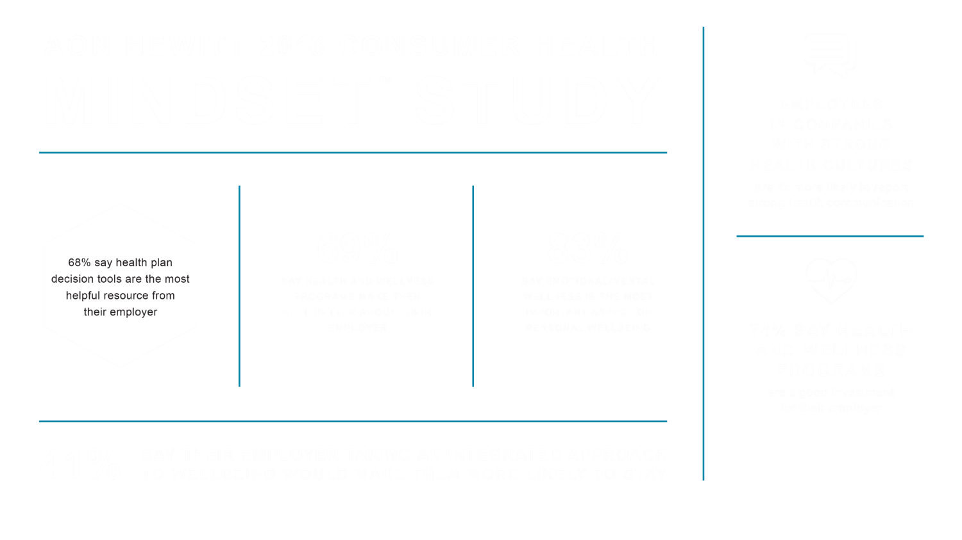

Slide 11



Emotional Well-Being’s Most Important
Importance of These Attributes in
My Personal Life Today
TOP TWO ASPECTS
of Emotional/Mental Health
Emotional/Mental 83%
Physical 79%
Financial 71%
Managing
my stress
Take reasonable
time off from work;
rest and relaxation
Social 45%
Source: 2016 Consumer Health Mindset Survey: Aon Hewitt, the National Business Group on Health, and The Futures Company
Notes:
One final observation as we wrap up.
All this total well-being chatter. You may wonder – like I did – if it resonates.
It does.
As a matter of fact, when we asked them about the importance of these 4 attributes in their personal lives,
EMOTIONAL – or mental – well-being came out on top—closely followed by physical and financial.
And, the top 2 aspects of emotion health to consumers are:
Managing their stress
Taking reasonable time of from work for rest and relaxation.

Slide 12



Expectations are High
77% | 89% | 55%
Say valuing their time is the most important thing a company can do Source: Forrester North America Technographics Survey Q4 2013 | Say they are frustrated by dealing with self-help sites that cannot answer customer questions Source: Accenture Global Consumer Pulse Survey | Are likely to abandon their online purchase if they can’t find a quick answer to their question Source: Accenture Global Consumer Pulse Survey

Slide 13


Mobile Dominates
Millennials | Centennials
Tech-savvy: 2 screens at once Communicate with text Curators and sharers Now-focused Optimists Want to be discovered | Tech-innate: 5 screens at once Communicate with images Creators and collaborators Future-focused Realists Want to work for success

Slide 14
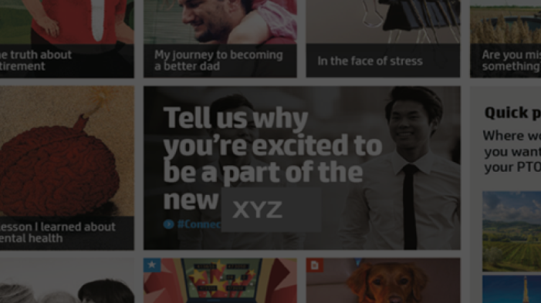
Journalistic Storytelling Resonates
Obesity rates:
>44%
by 2030
When people hear information, they’re likely to remember only 10% of it 3 days later. If paired with an images, they’ll retain 65% of the information 3 days later.
Source: Why InforgraphicsWork 5/12/15, www.lifelearn.com

Slide 15

Reimagining the Health Experience
Consumers Rule
Reimagining the Health Experience
Reimagining the Health Experience
Consumers Rule

Slide 16
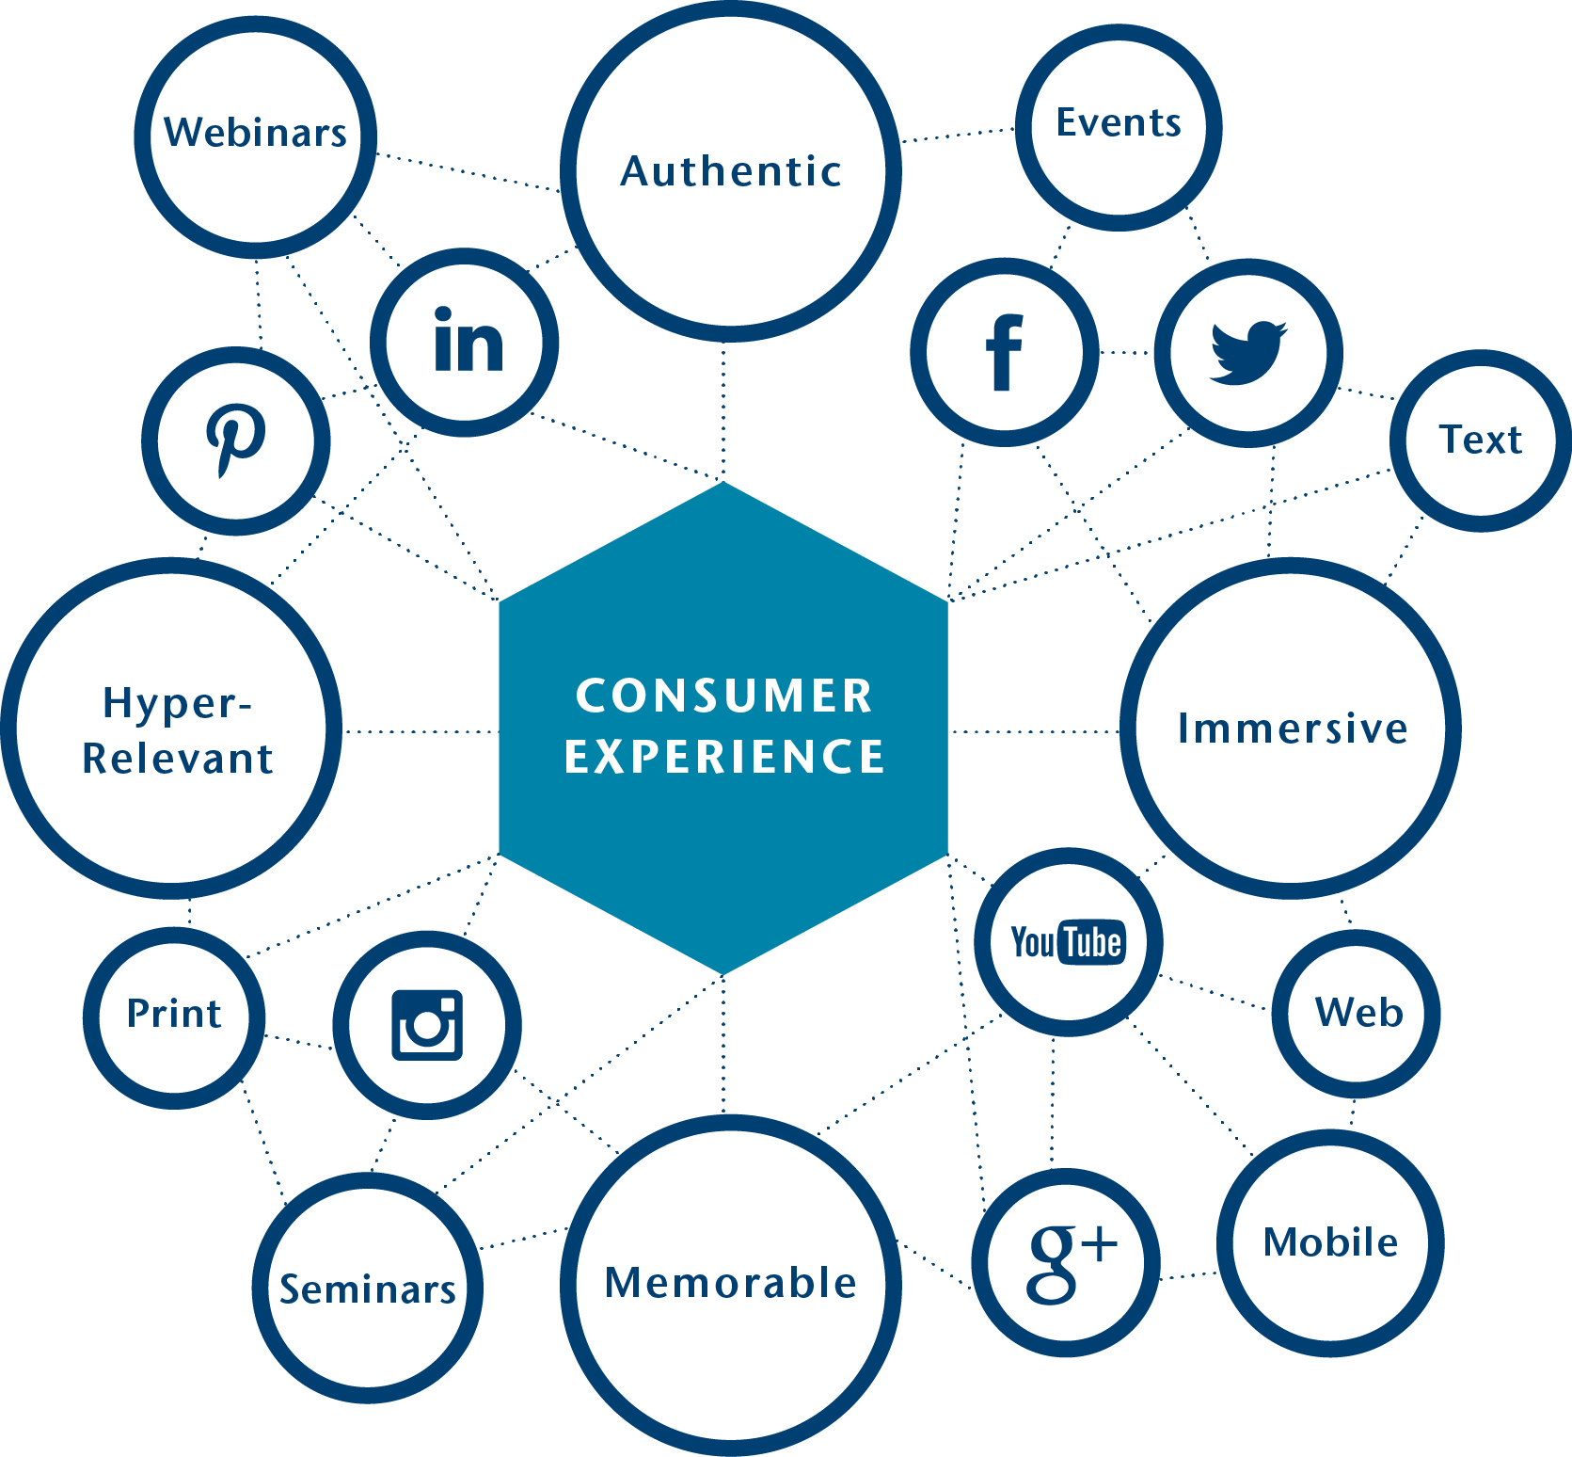
Our Value
We seamlessly combine human insights, creative strategy, and friendly technology to deliver experiences that move people to achieve greater outcomes for themselves and their employers.

Slide 17

OUR
ANTHEM
We are the instigators,
storytellers and strategists who inspire,
move and influence the people and
brands we love. And we see everything
from a consumer experience perspective.
Our strategic thinking is driven
by future integration,
scalability and possibility.

Slide 18
OUR
GAME CHANGER
Real Life
Marketing
Health Ecosystem
Human Resources

Slide 19



Our Approach
Human Insights | Creative Strategy | Friendly Tech
We capture and translate massive amounts of data to develop the employee profile and gather the ingredients for creating a truly authentic, ownable value proposition | We pressure-test the value proposition against everything that’s true about the brand, and reimagine the opportunities to differentiate the organization in a meaningful way. | We develop actionable strategies that align with the brand to create a roadmap for the organization that creates maximum impact with its desired audience results.

Slide 20

Reimagining the Health Experience
Consumers Rule
Reimagining the Health Experience
Reimagining the Health Experience
Human Insights

Slide 21
Problem to Solve ― We Have Too Many Problems…Where to Focus
Consumer Research
Communication Impact Assessment (CIA)
Concept Testing | Perception Index™ | Custom Survey | Opt-In Survey | Interviews | Focus Groups
Attitudinal Segmentation | Medical Opt-Out Survey | Annual Enrollment Survey | Customer Satisfaction Survey
Enable
Change
Connect to Visual, Values, and Goals
Fuel High Performance

Slide 22





Problem to Solve ― We Don’t Always Test Our Ideas in Advance
Concept Testing
Way to evaluate employees’ response to new brand, design, messages, or initiatives in advance
Interviews
Qualitative
Better for
complex topics
In-person Focus Groups
Qualitative
Better for
complex topics
Online Focus Groups
Qualitative and Quantitative
Better for
straightforward
topics
Surveys
Quantitative
Better for
straightforward
topics
Split Testing
Quantitative
Best for estimating
behavioral impact

Slide 23

Reimagining the Health Experience
Consumers Rule
Reimagining the Health Experience
Reimagining the Health Experience
Creative Strategy

Slide 24
Problem to Solve ― Employees Don’t Know How to Maximize CDHPs
CDHP Marketing
Cracking the Code to CDHP Engagement
Leverage Insights
Build Confidence
Ignite
Success

Slide 25




Problem to Solve ― We Need to Make This Wellbeing Craze Real
Wellbeing Strategy
Emotional | Physical | Financial | Social
Assessment
and Analysis
Employee Engagement
Strategy
Tactics
Employee Listening
Executive Interviews
Segmentation Analysis
Vision and Mission
Statement
Audience Analysis
Brand Development
and Launch
Evidence-driven Recommendations
Voice and Style
Ongoing Communications
Challenges and Campaigns
Incentive Design
Offline and Online Populations
Special Interest Groups

Slide 26

Problem to Solve ― It’s Unclear What Will Drive Results
Wellbeing Scoreboard
Financial
Physical
<36%
Debt-to-Income
6 months
Emergency Savings
11X
Retirement Readiness
<25%
Tobacco Use
<30
Healthy Weight/BMI
150/300
Physical Activity
Wellbeing Scoreboard
Emotional
Social
Stress
Belonging
Depression
Reported Level of Personal Support
Likelihood to Volunteer
Involvement to Community

Slide 27

Reimagine Away

Slide 28
Thank You

