Slide 1
Human Insights Report
Note: The speaker notes for this slide include detailed instructions on how to insert a Title Slide with a different image.
Tip! Remember to remove this text box.
Penske Employer Message Framework
Notes:
This is a sample Title Slide with Background Image ideal for including a dark Image with a brief title and subtitle.
A selection of pre-approved Title Slides are available in the CE_Aon Led_Title Slide Library_Widescreen on the Consumer Experience KE site.
To insert a slide with a different picture from the CE_Aon Led Title Slide Library:
Open the file CE_Aon Led_Title Slide Library_Widescreen.pptx
From the Slide thumbnails pane, select the slide with the picture you would like to use in your presentation and click Copy (Ctrl+C)
Open a copy of the new CE _Aon_Led_Widescreen template or your current presentation
In the Slide thumbnails pane, click Paste (Ctrl+V)
A Paste Options clipboard icon will appear. Click the icon and select Keep Source Formatting (Ctrl+K)

Slide 2




Critical Talent Needs
& Motivators
Desired employment
experience
Communication
preferences
The Penske Experience
What it’s like to work at Penske
What’s unique and
differentiating
How Penske stacks up
TODAY’S FOCUS
Employer Message
How to position Penske as an employer of choice in a way that is meaningful to current and future critical talent
Communication
Business communication
HR & benefits communication
Job-related communication
Candidate communication

Slide 3


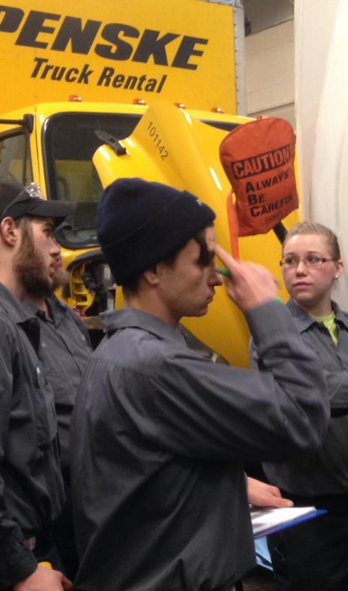
“
“
Everybody here—we all
get along.”
Warehouse, Detroit
It all starts with Roger and Brian. They know to the bone that Penske is the best place to work, that we’re the best at what we do. That means our message to associates is ‘you’re the best.’”
Subject Matter Expert
“
“
If you look at Penske, the owner, Roger, he’s popular
and determined. He’s a great business man.”
Driver, Dallas
Communication is very
U.S. centric.”
Canada Rental Associate

Slide 4
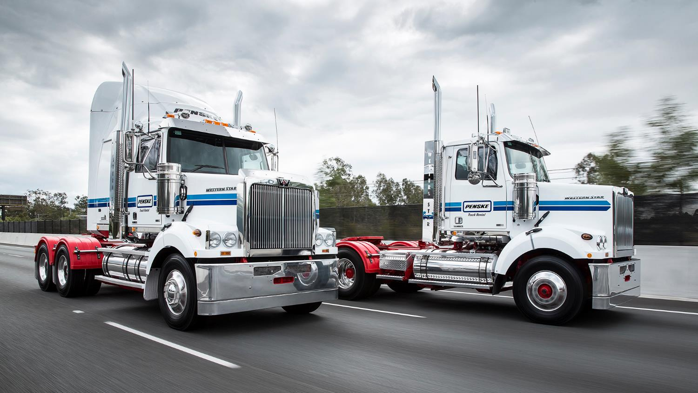
“
“
It’s totally in your control if you want to advance your career; there are opportunities nationwide to do so. If you want to develop yourself and stay in one place, you can do that.”
District Manager
If you look at Penske, the owner, Roger, he’s popular
and determined. He’s a great business man.”
Driver, Dallas

