Slide 1
Retirement & Investments Solutions
Services
Advise/Sponsor
Delivery/Employee
Administration
#1 DB provider⁵
Top 5 DC provider⁶
Delegated Investment Management
$87B⁴ in assets under delegation across 253 clients globally
Brokerage Window
$4.9B and 48,000
accounts on our U.S. brokerage platform⁷
Traditional Investment Consulting
$4T² assets under advisement globally
#1 U.S.by assets under advisement³
Comprehensive and Unified Support
Thought Leadership
Participant Advisory
$14B DC assets under
management⁸
Financial Independence
Seamless Participant Experience
Actuarial Consulting
#2 U.S. firm by number of plans and assets Enrolled Actuary¹
Lead consultant in many of the largest pension settlements of this decade
Communications
100 awards for quality and innovation⁹
900 clients¹⁰
Institutional scale
¹ 2014 Form 5500 Filing U.S.
² As of 6/30/15
³ P&I, 2015 Inv Mgt Consultant Survey, U.S. Inst Tax-Exempt Assets
⁴ As of 3/31/16
5 PLANSPONSOR 2015 Recordkeeping Survey, by participants (U.S.)
⁶ P&I DC Record Keepers Survey, by assets and participants, 9/30/15
⁷ As of 1/31/16
⁸ As of 3/1/16
^{9,10} As of 3/1/16

Slide 2




Financial Wellbeing Stages
FREEDOM (9%)
GROWTH (36%)
FOUNDATION (25%)
SECURITY (30%)
Financial Counseling & Education
Budgeting & Financial Basics
Savings & Investing Help
Financial Wellbeing Stages
Financial Planning
Retirement Income

Slide 3
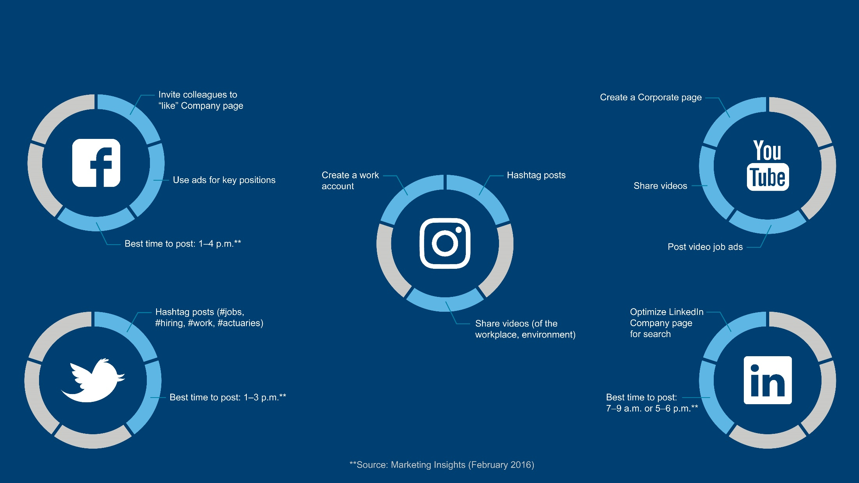
TOP SOCIAL MEDIA CHANNELS & TIPS

Slide 4
Key Audiences and Preferences
Audience | General Needs and Communication Preferences*
Candidates
New college graduates/campus | Looking for relevant opportunities, learning and development, recognition, collaboration, strong company reputation, and work/life balance and work flexibility Want challenges, variety with multiple career paths, opportunity to build skills, to make an impact, Mobile, social, electronic—casual, fun, irreverent, clear
Mid- to senior-level hires | Looking for strong brand reputation, rewards, and recognition Want challenges, to be recognized as an expert, and do what they do best Mobile, print, and electronic—candid, efficient, direct, fast, fun
Diversity/inclusion candidates | Also looking to see how Aon supports diversity and inclusion efforts (e.g., percentage in leadership roles, BRG structure and business impact, support resources)
*Sources: The Futures Company MindBase segmentation data; Aon Engagement and other employer brand research, 2016 Workforce Mindset™ study.

Slide 5
Key Audiences and Preferences
Audience | General Needs and Communication Preferences*
Colleagues
High potentials/high performers | Performance management is even more important to this audience (goal setting, assessing performance against peers, and interactions with leaders) Value diversity and inclusion, strong manager relationships, training and development Communication directly from leaders more important for this audience
Leaders/managers | Looking for rewards and recognition, diversity and inclusion, and collaboration Similar needs to mid- to senior-level hires Mobile, email, desktop media, print—authentic, direct and to-the-point
Colleagues | Key engagement drivers are career opportunities, recognition, company reputation, and teamwork See channel strategy below
*Sources: The Futures Company MindBase segmentation data; Aon Engagement and other employer brand research, 2016 Workforce Mindset™ study.

Slide 6




CHANNEL STRATEGY
 | Candidate (including colleagues as candidates) | Colleague | Use These Channels When You Want to…
Digital & Social | Aon’s Career Site Social Networks (LinkedIn, Facebook, Instagram, Pinterest, Google+, YouTube) Aon Careers Twitter Handle Job Board (Indeed, Monster, CareerBuilder, Glassdoor) Open Opportunities Aon Avenue Email | Aon Avenue Social Networks (Yammer, Facebook at Work) Email | Create awareness, build brand, take action Create knowledge and understanding Create conversations with different audiences Engage people to be ambassadors for the brand Create real-time responses/dialogue to things happening in the industry/workplace, or to things relevant to our audiences* Note: Colleagues prefer email and websites for information on what’s happening in the organization, goals, priorities, performance*
People | Current Internal Aon Colleague (Transfer or Referral) Staffing Agency Direct Sourcing Contractor/Temporary Conversion Recruiters and Staffing Agencies Leaders Managers, including hiring managers Colleagues Alumni Professional Associations | Aon Avenue Social Networks (Yammer, Facebook at Work) Email | Create awareness, build brand, take action Create knowledge and understanding Create conversations with different audiences Engage people to be ambassadors for the brand Create real-time responses/dialogue to things happening in the industry/workplace, or to things relevant to our audiences* Note: Colleagues prefer email and websites for information on what’s happening in the organization, goals, priorities, performance* *Source: 2017 Workforce Mindset™ study
Experiential | University recruiting Career job fairs Market hire Community events | Empower Results Days Physical locations (including break rooms and cafeterias) Local “townhalls” Community events | Create awareness, encourage action Create immersive brand experience Create live dialogue with audience Create meaningful interactions that engage Capture audience information for future communication Build brand
Traditional | Direct mail Print advertising in magazines and trade publications | Desk Drop Home Mailing Publications | Use as a driver, integrating with digital or other media where applicable Create knowledge and understanding Encourage action Generate brand awareness and consideration

Slide 7



SOCIAL MEDIA STATS
56%
60,000
50%
of recruiters say they find some of their best candidates through social networks, followed by online job boards at 37%. Source: Social Times (September 2015)
On average, more than 60,000 jobs are tweeted each day—Twitter is being utilized by about 40% of companies to source talent. 54% use Facebook, 8% use Google+ and YouTube. Source: Society for Human Resource Management
of job seekers use Glassdoor in the beginning stages of the job search to narrow down potential employers (Source: Recruiting Daily)

Slide 8



SOCIAL MEDIA STATS
100x
120%
650%
Instagram has the highest engagement of any of the top social media (10x more than Facebook and 100x more than Twitter)
Tumblr's active user base has grown by 120%; Pinterest's active user base has grown by 111%; Instagram's active user base has grown by 64%. (Source: Inc, November 2015)
Posts that include images produce 650% higher engagement than text-only posts.

Slide 9




SOCIAL MEDIA STATS
85%
3x
87%
150%
People are 85% more likely to buy a product after viewing a product video.
Posts with videos attract 3x more links than text-only posts.
Facebook posts from brands that included images earned 87% of all engagements
Tweets with images earned up to 18% more clicks, 89% more favorites, and 150% more retweets
Source: Inc, November 2015

